Slide 1

Parkinson’s Seminar
Raashay kee bemari ka muqabla dawa aur dua key saath
Jointly organized by
Pakistan Parkinson’s Society
&
of Pakistan Society of Neurology
Jinnah Hospital Najam-uddin Auditorium
25 September 2010

Slide 2
Today’s Program
Arrival of Guests / Registration
Recitation of Holy Quran
Introducing Pakistan Parkinson’s Society
Introduction of Faculty
  Prof Dr Shaukat Ali
  Dr Mariam Syeda
  Omar Iftikhar
  Salman Shareef
  Haroon Basheer
  M Irshad Jan
Ice breaker Haroon Basheer
Key note address Dr Shaukat Ali
Speech Therapy intervention Dr.Mariam Syeda
Intro to complementary Therapy Omar Iftikhar
Exercise tips Video
Parkies take the stage Salman Shareef
Q&A Panel
Refreshments

Slide 3
        Introduction of
        FACULTY

Slide 4
Faculty
Prof Dr. Shaukat Ali
Senior Consultant Neurologist
  Head of Neurology JPMC
  President Pakistan Society of Neurology
  President Epilepsy Society

Slide 5
Faculty
Dr Mariam Hadi Syeda
Speech Language Pathologist
Masters in Speech Pathology NorthEastern University US
Faculty Member Ziauddin College of Speech Therapy

Slide 6
Faculty
Salman Shareef
  PD Patient
  Ex Country Head Pesticide Multinational
  Director Advisory Board, Pakistan Parkinson’s Society
  Active member of Society

Slide 7
Faculty
Omar Iftikhar
Energy Therapist
Reiki Master
Private Practice

Slide 9
Haroon Basheer
Chairman
Pakistan Parkinson’s Society
Former Head of Citibank CSG, American Express TRS and Banking Mohtasib

Slide 10
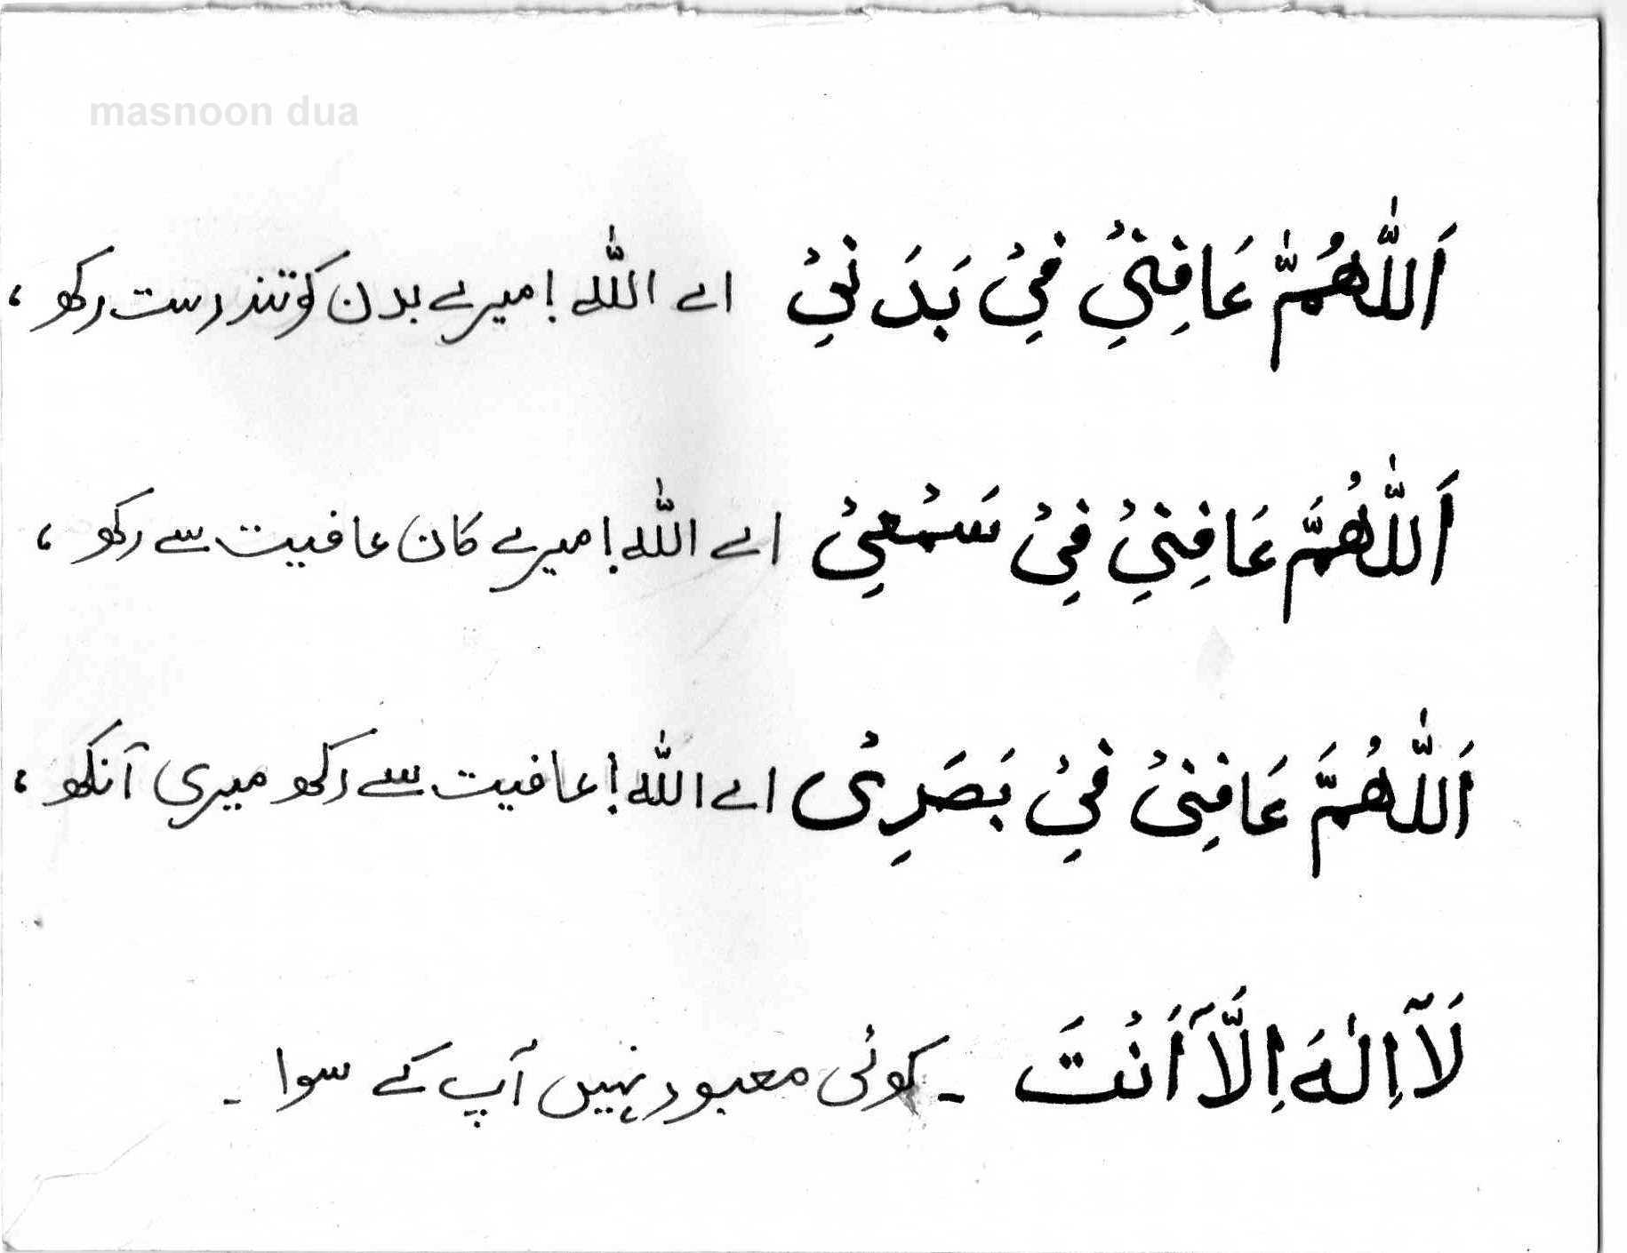
Masnoon Dua

Slide 11
Incidence of PD
Parkinson’s disease affects about
  1 of 250 people older than 40
  1 out 100 people older than 65
  1 of 10 older than 80.
It commonly begins between ages of 50 and 79.
Rarely occurs in children or adolescents Source: www.merck.com
Parkinson’s disease affects about
  1 of 250 people older than 40
  1 out 100 people older than 65
  1 of 10 older than 80.
It commonly begins between ages of 50 and 79.
Rarely occurs in children or adolescents Source: www.merck.com

Slide 12
Incidence of Parkinson’s in Pakistan
No research available on incidence of disease in Pakistan
In a study conducted covering most populous countries of the world, estimated PD cases in Pakistan are around 450,000* and there are possibly another 500,000 who have never consulted a doctor
*Figures estimated based on incidence in India

Slide 13
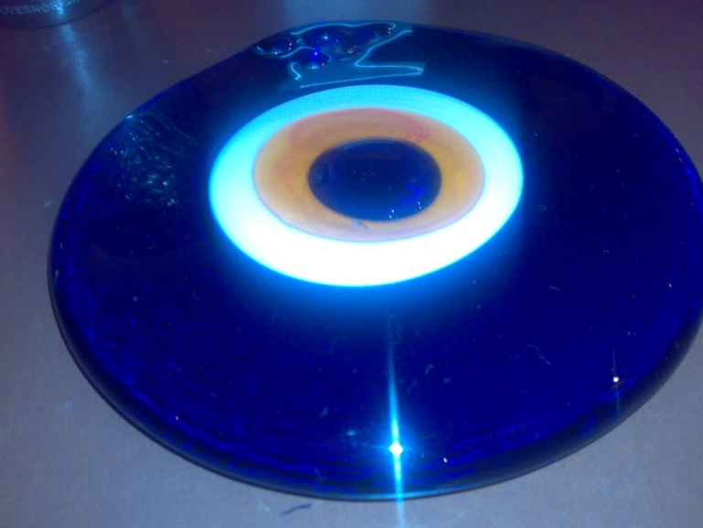
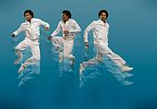



Our mission
To cultivate hope and promote wellness in PD patients

Slide 14


14

Slide 15
Our Aim- The Pakistan Parkinson’s Society will
Encourage Persons with Parkinson’s to
take charge and live life fully
Raise awareness among masses
Show support to people living with Parkinson's along with their families, caregivers and friends
Bring best practices from advanced countries to improve quality of life in patients
Create awareness of complementary strategies, Exercise, Physiotherapy, Occupational therapy, Speech therapy, Music therapy etc

Slide 16
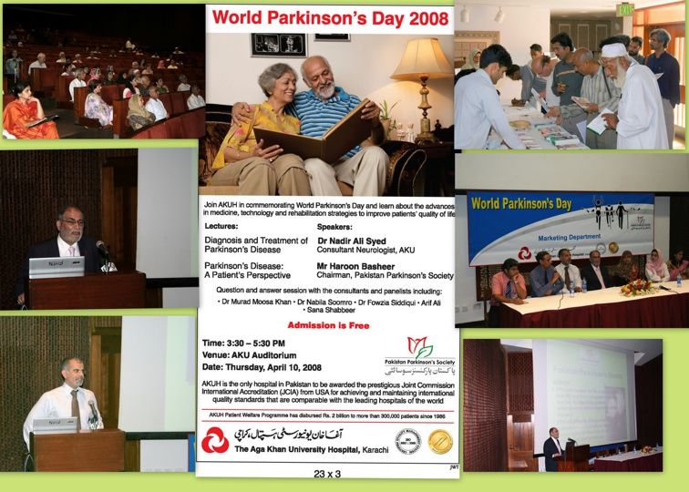

World Parkinsons Day seminar - April 2008

Slide 17
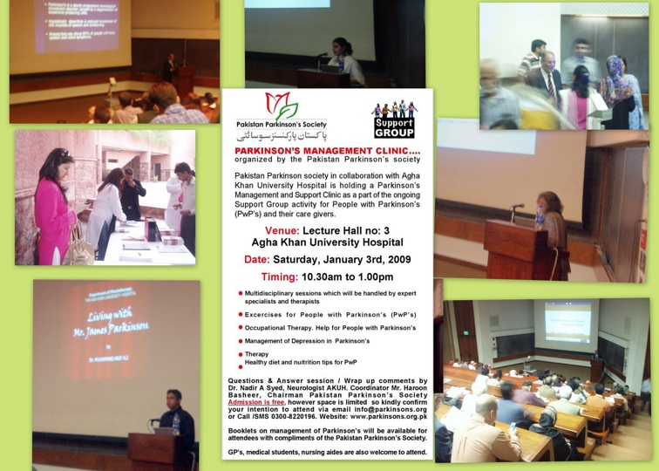
Parkinsons Management clinic - Jan 2009

Slide 18
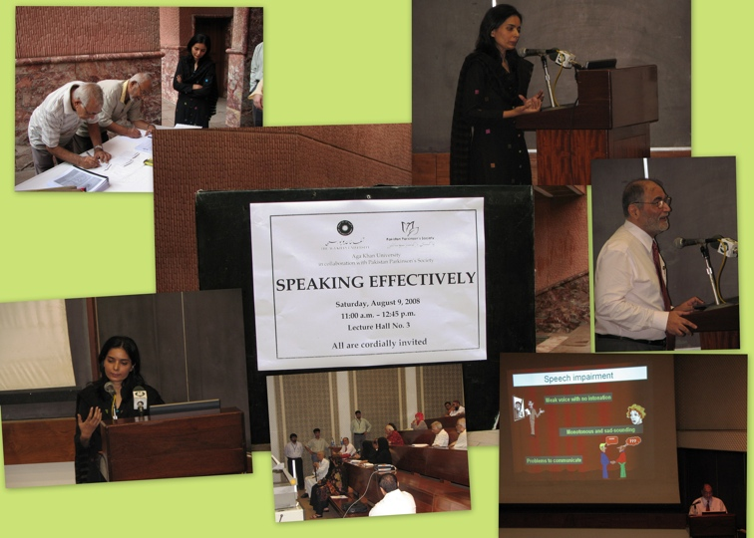
Seminar on Effective Speaking Techniques - August 2008

Slide 19
19

Slide 20
Issues in Pakistan
Limited number of neurologists
GP as first point of contact have little knowledge of disease
Movement disorder clinics excellence centers missing
Doctors have limited material / time
Patient not fully briefed on importance of self management
Awareness limited - no research on incidence, estimated 4,50,000 afflicted
Nursing specialists ?
Lack of support groups & possible social stigma ?
Career dilema no counselling
Deep brain stimulation ? - Cost US$40k / India US$10k

Slide 21
21

Slide 22


Living with Parkinson’s
“Dance as if no one were
watching, sing as if no one were listening,
and live everyday as if it
were to be your last.”
22
Aasman

Slide 23
23

